Slide 1
Personal budget tracker
Team ID: IMPHAC24TM169

Slide 2
CONTENTS
Introduction
Problem Statement
Solution Overview
Areas Of Focus
Summary

Slide 3
Introduction & Problem Statement
The Financial Challenge
Rising Living Costs: Increasing expenses without clear tracking
Lack of Financial Awareness: Difficulty in understanding spending habits
Ineffective Budgeting Tools: Existing solutions are often complex or inadequate
Impact: Financial stress and inability to save effectively

Slide 4
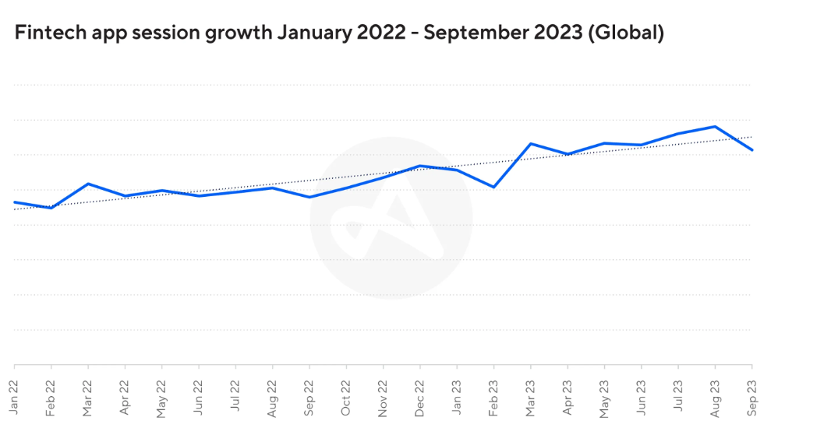
User Needs & Market Opportunity
Ease of Use: Simple and intuitive interface for all age groups
Comprehensive Tracking: Automatic categorization of expenses
Personalized Insights: Actionable analytics to improve spending habits
Financial Goals: Tools to set and achieve savings targets
Security: Robust data protection and privacy features
Supporting Statistic: e.g., “25% of users seek better budgeting tools" (Insert relevant data)

Slide 5
Core Functionalities
Expense Categorization:
Automatic sorting of transactions
Custom category creation
Income Tracking:
Multiple income sources
Recurring income management
Budget Planning:
Monthly/Weekly budget setup
Alerts for overspending

Slide 6
Advanced Features
Insights & Analytics:
Visual charts and graphs
Spending trend analysis
Savings Goals:
Set and monitor financial targets
Progress tracking
Bill Reminders:
Notifications for upcoming payments
Avoid late fees
Integration:
Sync with bank accounts and credit cards
Import/export data seamlessly

Slide 7
Why Choose Our App
User-Friendly Interface:
Easy navigation and clean design
Personalization:
Tailored recommendations based on spending habits
Real-Time Updates:
Instant transaction syncing and updates
Enhanced Financial Control:
Empower users to make informed financial decisions
Community & Support:
Access to financial tips and customer support

Slide 8
WEALTH IS THE ABILITY TO FULLY EXPERIENCE LIFE.
-Henry David Thoreau

Slide 9
TYPES OF TOKENS
Payment
Utility
Security
NFT
Gaming
Used to complete transactions anywhere crypto is accepted
These tokens have a specific use within a blockchain
Tokens backed by securities
Authenticates ownership of specific assets
Used as in-game currency and traded with real world value

Slide 10





PORTFOLIO BUILDUP
Step 1
Step 2
Step 3
Step 4
Step 5
Choose a cryptocurrency exchange
Purchase preferred coins & create "wallet"
Research investment and trading options
Stake preferred coins in chosen company
Set exponential growth goals

Slide 11
AREAS OF FOCUS
Portfolio diversification
Short and long-term goals
Develop winning combinations to stay ahead of the market
Capitalize on direct ownership of digital coins
Invest in multiple blockchains​
Create an emergency fund
Add a second stream of income
Buy a house
Supplement retirement fund

Slide 12
HOW TO GET THERE
Strategize
Minimize risk
Utilize resources
Do your research and develop a plan with goals
Diversify your portfolio through coin ownership​
Follow the markets closely​
Be cautious of scams and "too good to be true" scenarios
Avoid "all-in" strategies
Apps and platforms help streamline user experience
Seek expert guidance from Krypto Logics team members​

Slide 13

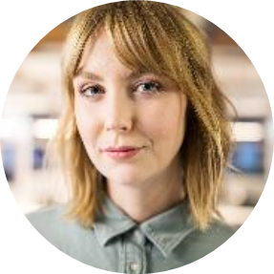

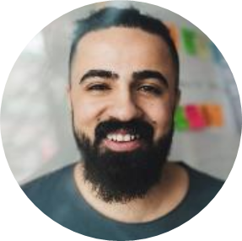
MEET OUR TEAM
Takuma Hayashi​
Mirjam Nilsson​
Flora Berggren​
Rajesh Santoshi​
President
Chief Executive Officer
Chief Operations Officer
VP Marketing

Slide 14




MEET OUR EXTENDED TEAM
Takuma Hayashi​
Mirjam Nilsson​
Flora Berggren​
Rajesh Santoshi​
President
Chief Executive Officer
Chief Operations Officer
VP Marketing
Graham Barnes
Rowan Murphy
Elizabeth Moore
Robin Kline
VP Product
SEO Strategist
Product Designer
Content Developer

Slide 15
Summary:
Comprehensive budgeting tool
Insightful analytics
Secure and reliable
Next Steps:
Build an app from [App Store/Google Play]
Sign up for a free trial
Join our community for tips and support

Slide 16
THANK YOU
Contact Information:
Name: V.S.KARTHIK
Email: 2310030324@klh.edu.in

